Slide 1
University of Diyala
College of Engineering
Department of Electronics Engineering
Course Number: U103
Course Name: Computer Science
Lecture (6)
Asst. Lect. Wurod Qasim Mohamed

Slide 2
Operating System Windows
More than a billion people use Microsoft Windows every day. You use it in significant ways, like earning a living and academic knowledge. In designing Windows 7, we focused on creating a better experience, regardless of what you do on your PC. And we will learn some architecture of Windows 7.
There are multiple editions of Windows 7. And because your needs can change over time, you can move up to editions with more features, without giving up the features you already have as the following figure.

Slide 3
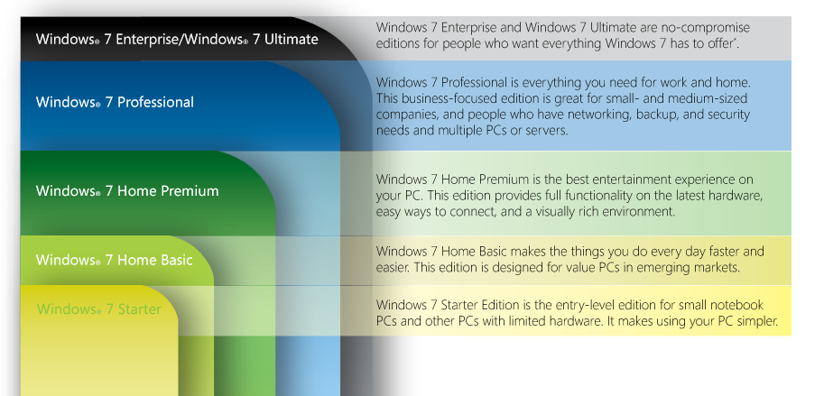

Slide 4
Right click on Desktop

Slide 5
View: help you to change the size of desktop icons by select:
Large icons
Medium icons
Small icons
Also help you to hide the desktop icons or show them.
Sort by: help you to arrange the desktop icons depending on:
Name
Size
Item type
Data modified

Slide 6
Refresh: to refresh (active) your desktop or computer.
Paste: to paste the selected file or folder in somewhere with saving two separate files or folders.
Paste shortcut: to paste the selected file or folder in somewhere with saving two dependent files or folders. For example: any change into one of these file will be occurred in the other immediately.
New: to open a new file or folder on desktop
Display sittings: to set the brightness, color, landscape,.., etc of the desktop, and the other system sitting.
Personalize: help you to adjust or change the background of the computer.

Slide 7
Start menu: help you:
to open any program that is already installed in the computer.
To open control panel which is able to change settings and customize the functionality of the computer.

Slide 8
Practical Laboratory Part

